Slide 1
Retail Sales Prediction May Placement Project
Sreelakshmi K

Slide 2
Contents
Problem Statement
Basic Investigation of Datasets
Data Cleaning
EDA (Exploratory Data Analysis)
EDA Summary
Data Pre-processing
Model Building
Evaluation of Model
Conclusion

Slide 3
Problem Statement
XYZ operates over 3000 drug stores in 7 countries, XYZ store managers are currently tasked with predicting their daily sales up to six weeks in advance. Store sales are influenced by many factors, including promotions, school and state holidays, seasonality and locality. With thousands of individual managers predicting sales based on their unique circumstances, the accuracy of results can be quite varied.
You are provided with historical data for 1115 XYZ stores. The task is to forecast the ‘Sales’ column for the test set. Note that some stores in the dataset were temporarily closed for refurbishment.

Slide 4
Basic Investigation of datasets
Sales Dataset
1017209 rows and 9 columns
All variables are of numerical datatype except Date and State Holiday
Sales and Customer values have high max values than 75th percentile value indicating presence of outliers
There are 172871 rows where either store is closed or sales is 0
Stores Dataset
1115 rows and 10 columns
All variables except Store Type, Assortment and Promo Interval are of numeric data type
Mean, Median and Max values of competition distance differs greatly indicating outlier presence

Slide 5
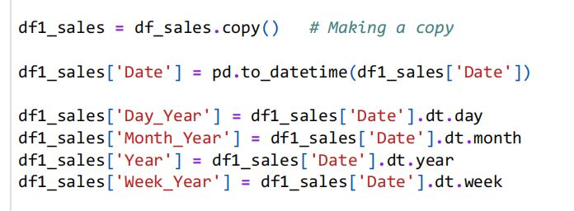
Data Cleaning
Sales Data
Handling missing and duplicate values
There are no missing values in the data set
No duplicate data in the data set
Converting Date variable to datetime format

Slide 6
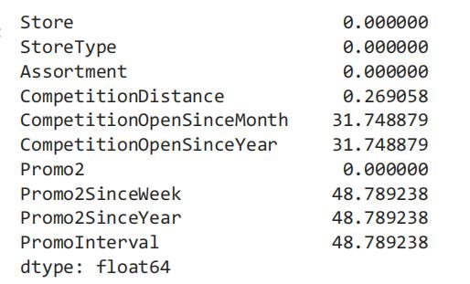
Stores Data
Missing and Duplicate Values
No Duplicates in the dataset
Missing values:
Since Missing value percentage is quite high
for ‘Promo Interval’ the column is dropped
Missing value for competition distance
replaced with median value
For other two cases since no additional
information is available missing value filled
with 0 by fillna() method

Slide 7

Exploratory Data Analysis (EDA)

Slide 8
Preparatory Steps
Joining Sales and Stores datasets
Selecting only those data where stores are open or sales not equal to zero
Shape of new data set:
844392 rows and 21 columns

Slide 9
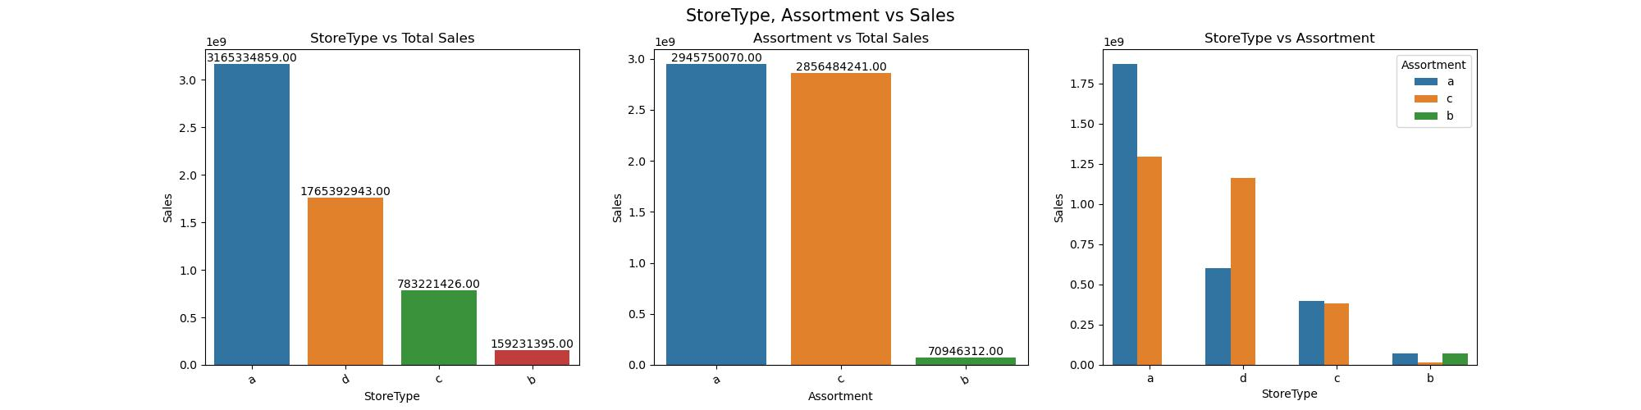
Visualization and Analysis of Independent Variables
Store Type and Assortment vs Sales
Store type a has maximum and b has minimum sales
Assortment type a has maximum sales as compared to other two types
Assortment type b is sold only by store type b

Slide 10
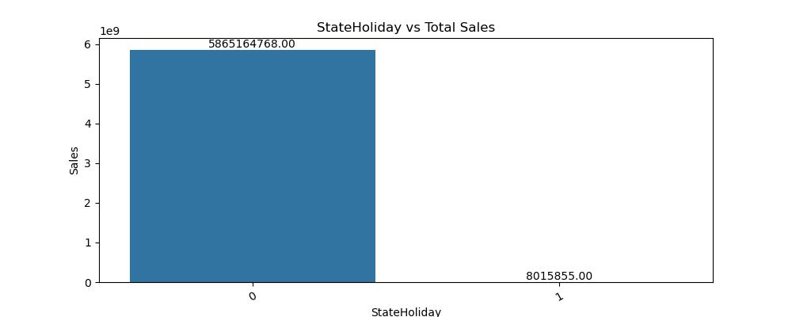
State Holiday vs Total Sales
0 indicates ‘None’ i.e not a state holiday and other three categories indicates public holiday, easter holiday and Christmas. Since most of the shops are closed during state holiday, sales is higher for days other than state holiday. Sales won’t be affected by state holiday

Slide 11
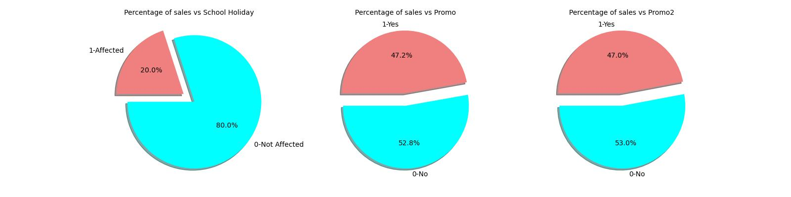
Impact of School Holiday and Promo on Sales
Sales is not affected by School Holiday
Sales are higher when any type of promo is going on

Slide 12
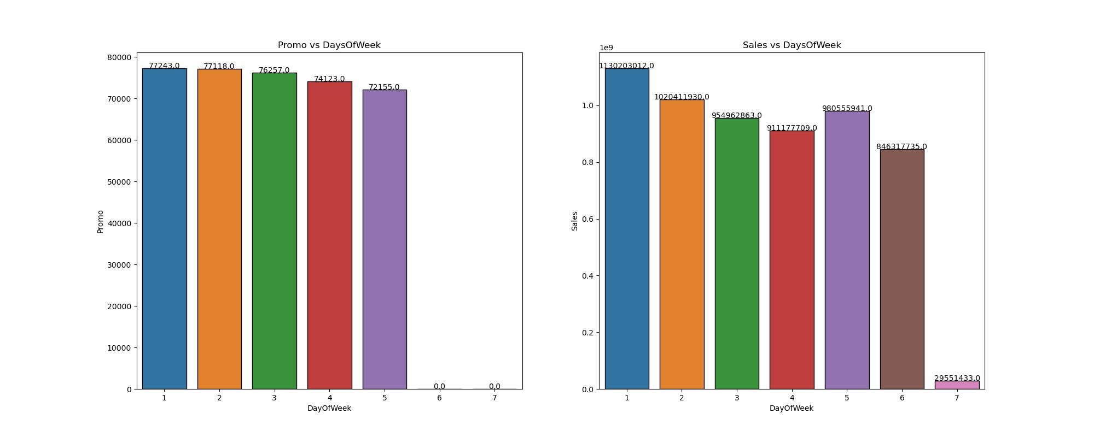
Day of week vs Promo and Sales
Most Promos are on Mondays and Tuesday, hence sales are high on these days
There are no promo on Saturdays and Sundays which might be a factor contributing to low sales on these days.

Slide 13
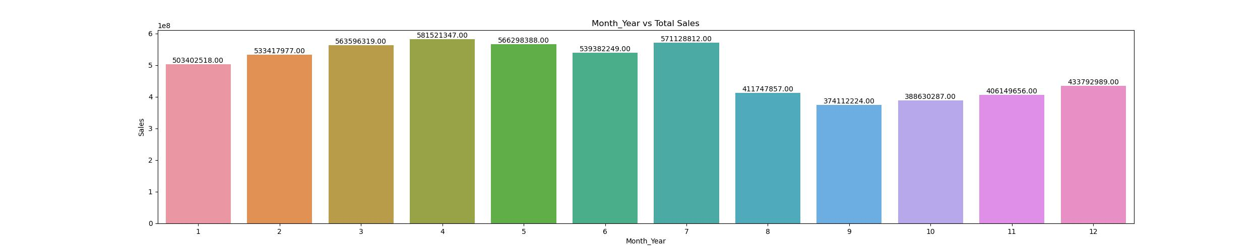
Month of Year vs Total Sales
Sum of sales is higher during the month of April

Slide 14
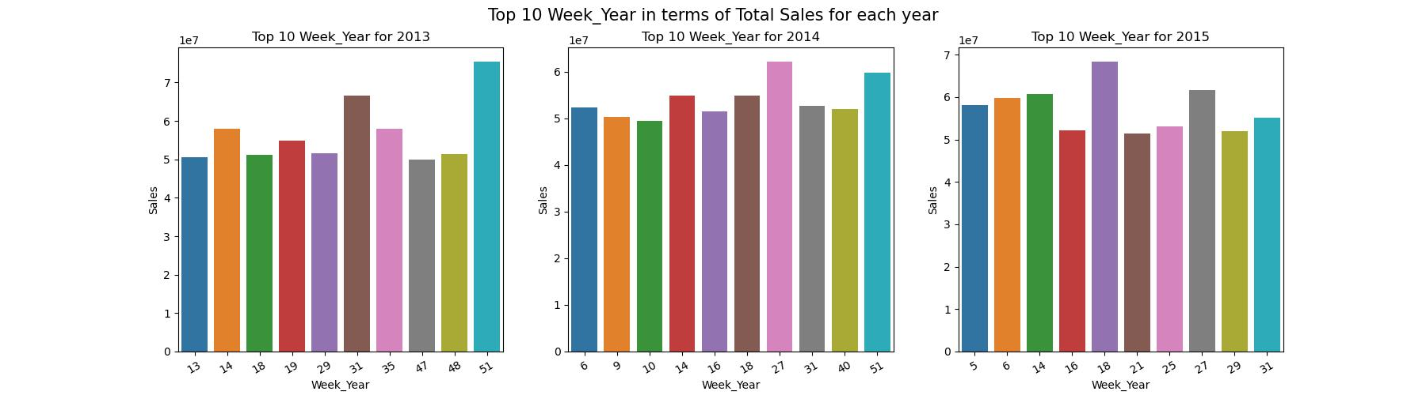
Week of Year vs Sales
For the year 2013 and 2014, sales is higher in week 51 which comes during Christmas season
For the year 2015 data till week 40 only is available, if the trend follows then for 2015 also sales will be higher during week 51

Slide 15
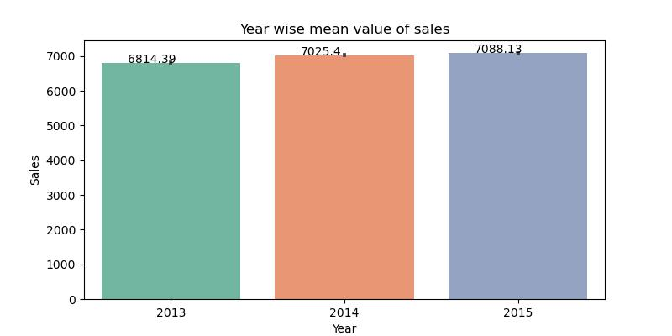
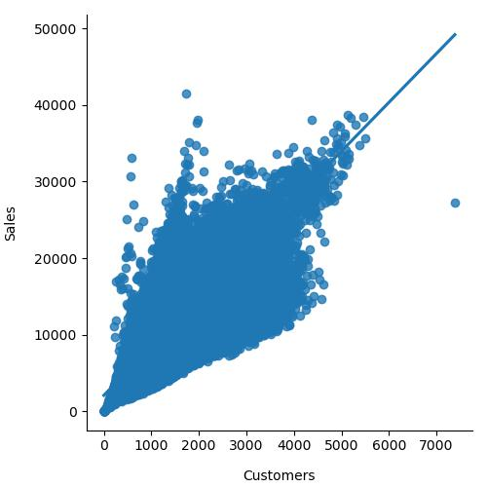
Average Sales vs Year
Customers vs Sales
Average Sales is higher for the year 2015
Customer variable has linear relationship with sales
Sales increases with increase in number of customers

Slide 16
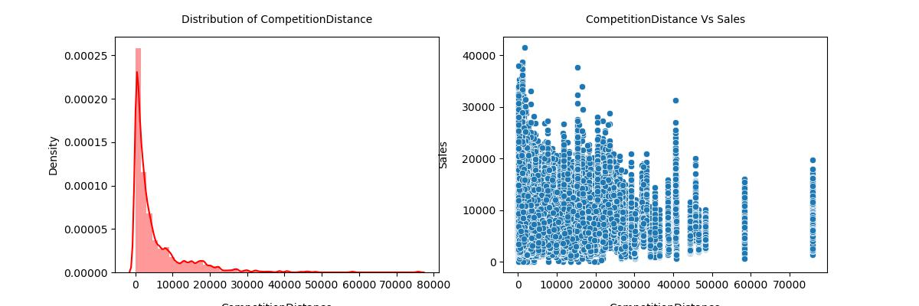
Competition Distance vs Sales
Distribution of competition distance indicates presence of outliers
Plot of competition distance do not display any trend or pattern with sales
The variable alone may not have any effect on sales and might be useful when considered along with other variables

Slide 17
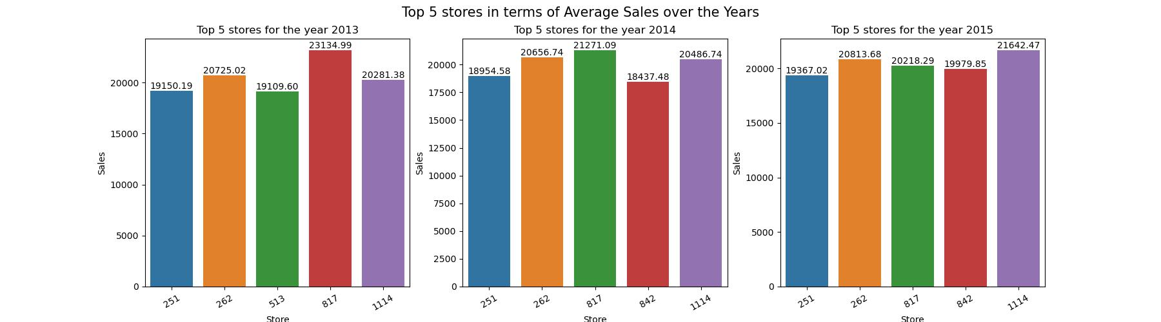
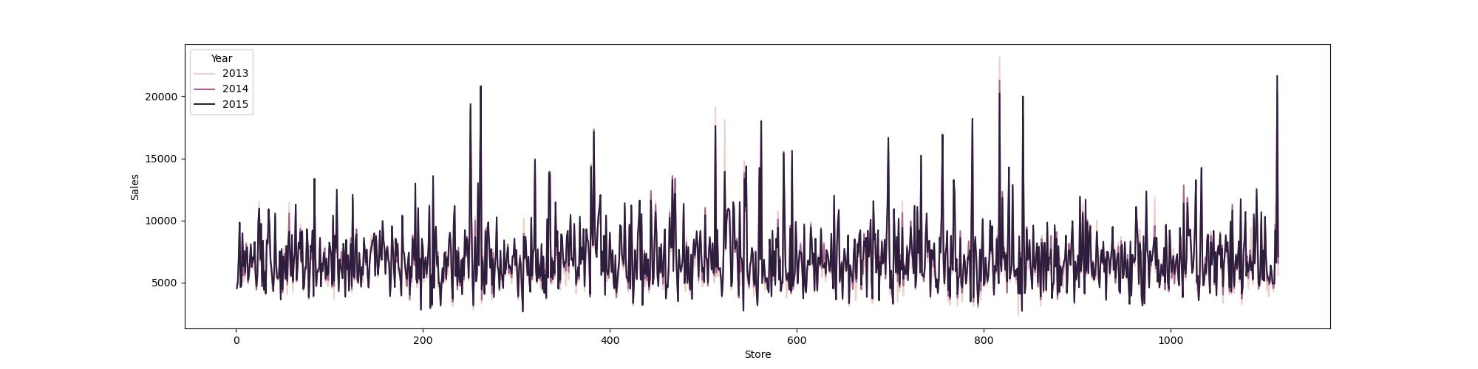
Top 5 stores in terms of Average Sales
Over the years the Top 5 stores in terms of Average sales are almost the same

Slide 18
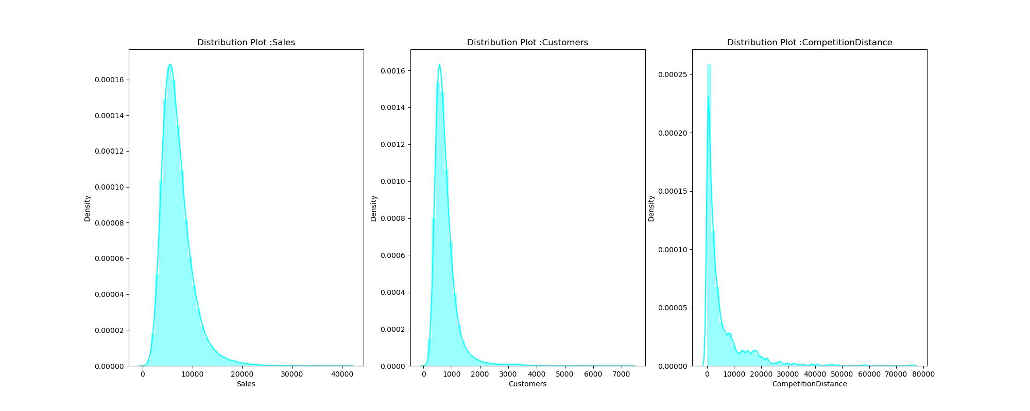
Distribution of continuous numerical features
Both Sales and customer distributions are normal distributions and right skewed
This indicates some unusually high values at the tail end

Slide 19
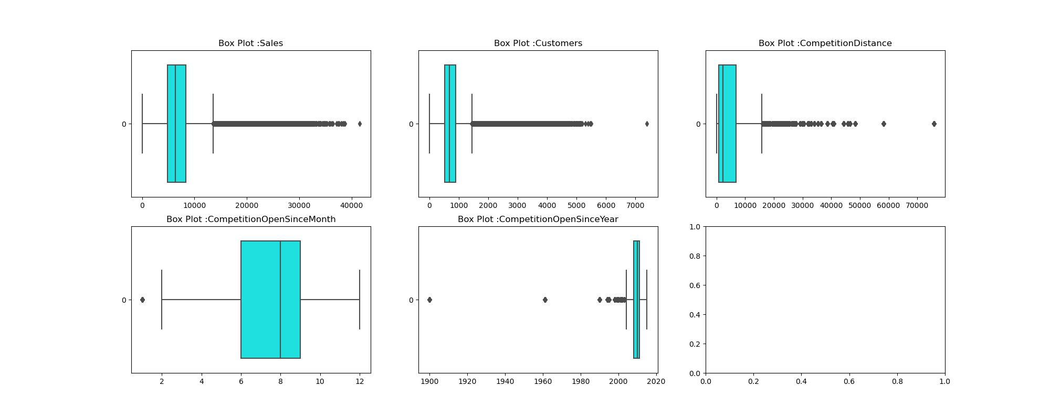
Visualizing Outliers

Slide 20
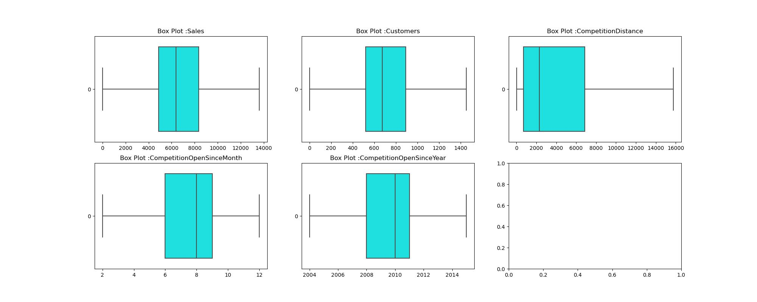
Box Plots After Outlier Treatment

Slide 21
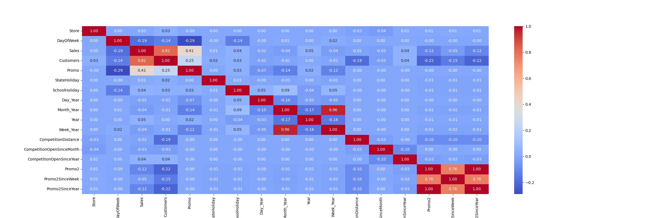
Correlation Matrix

Slide 22
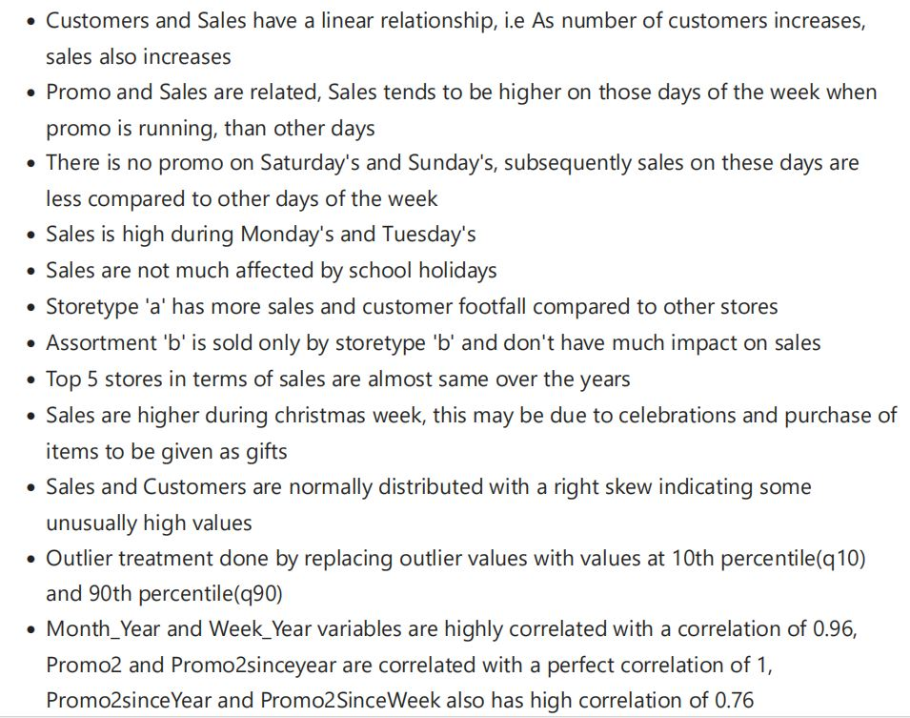
EDA Summary

Slide 23
Data Preprocessing
Encoding of Data
Dropping unwanted variables
Setting Feature and Target variables
Train Test Split
Standardization

Slide 24

Model Building
Linear Regression Model

Slide 25
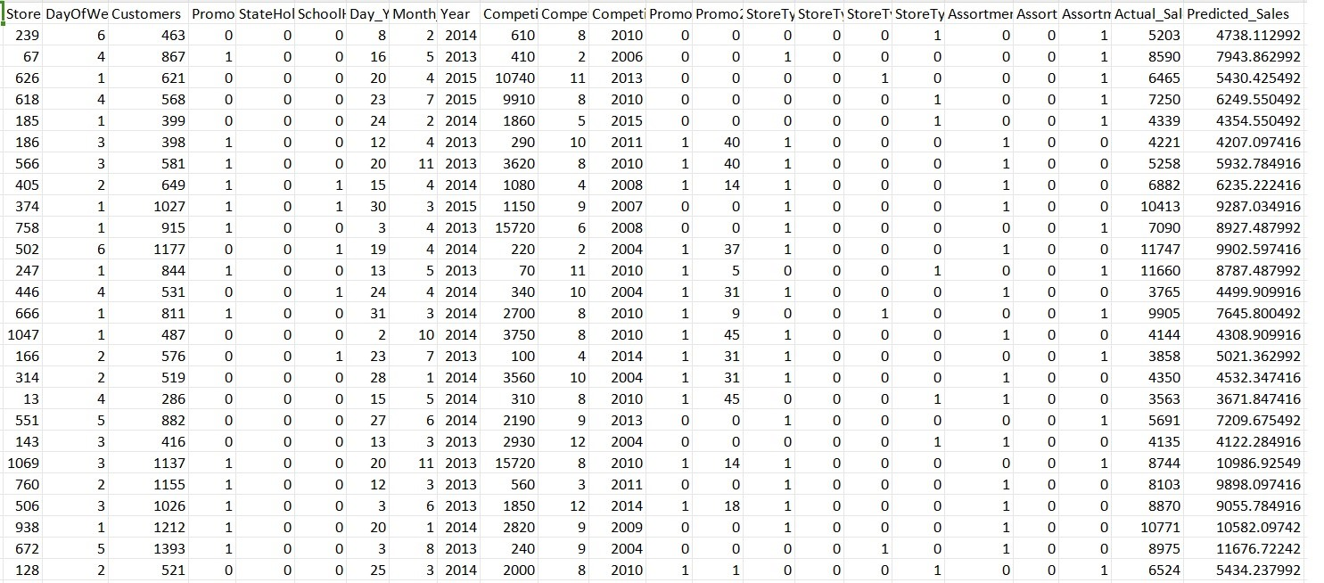
Actual and Predicted Sales for Test data

Slide 26
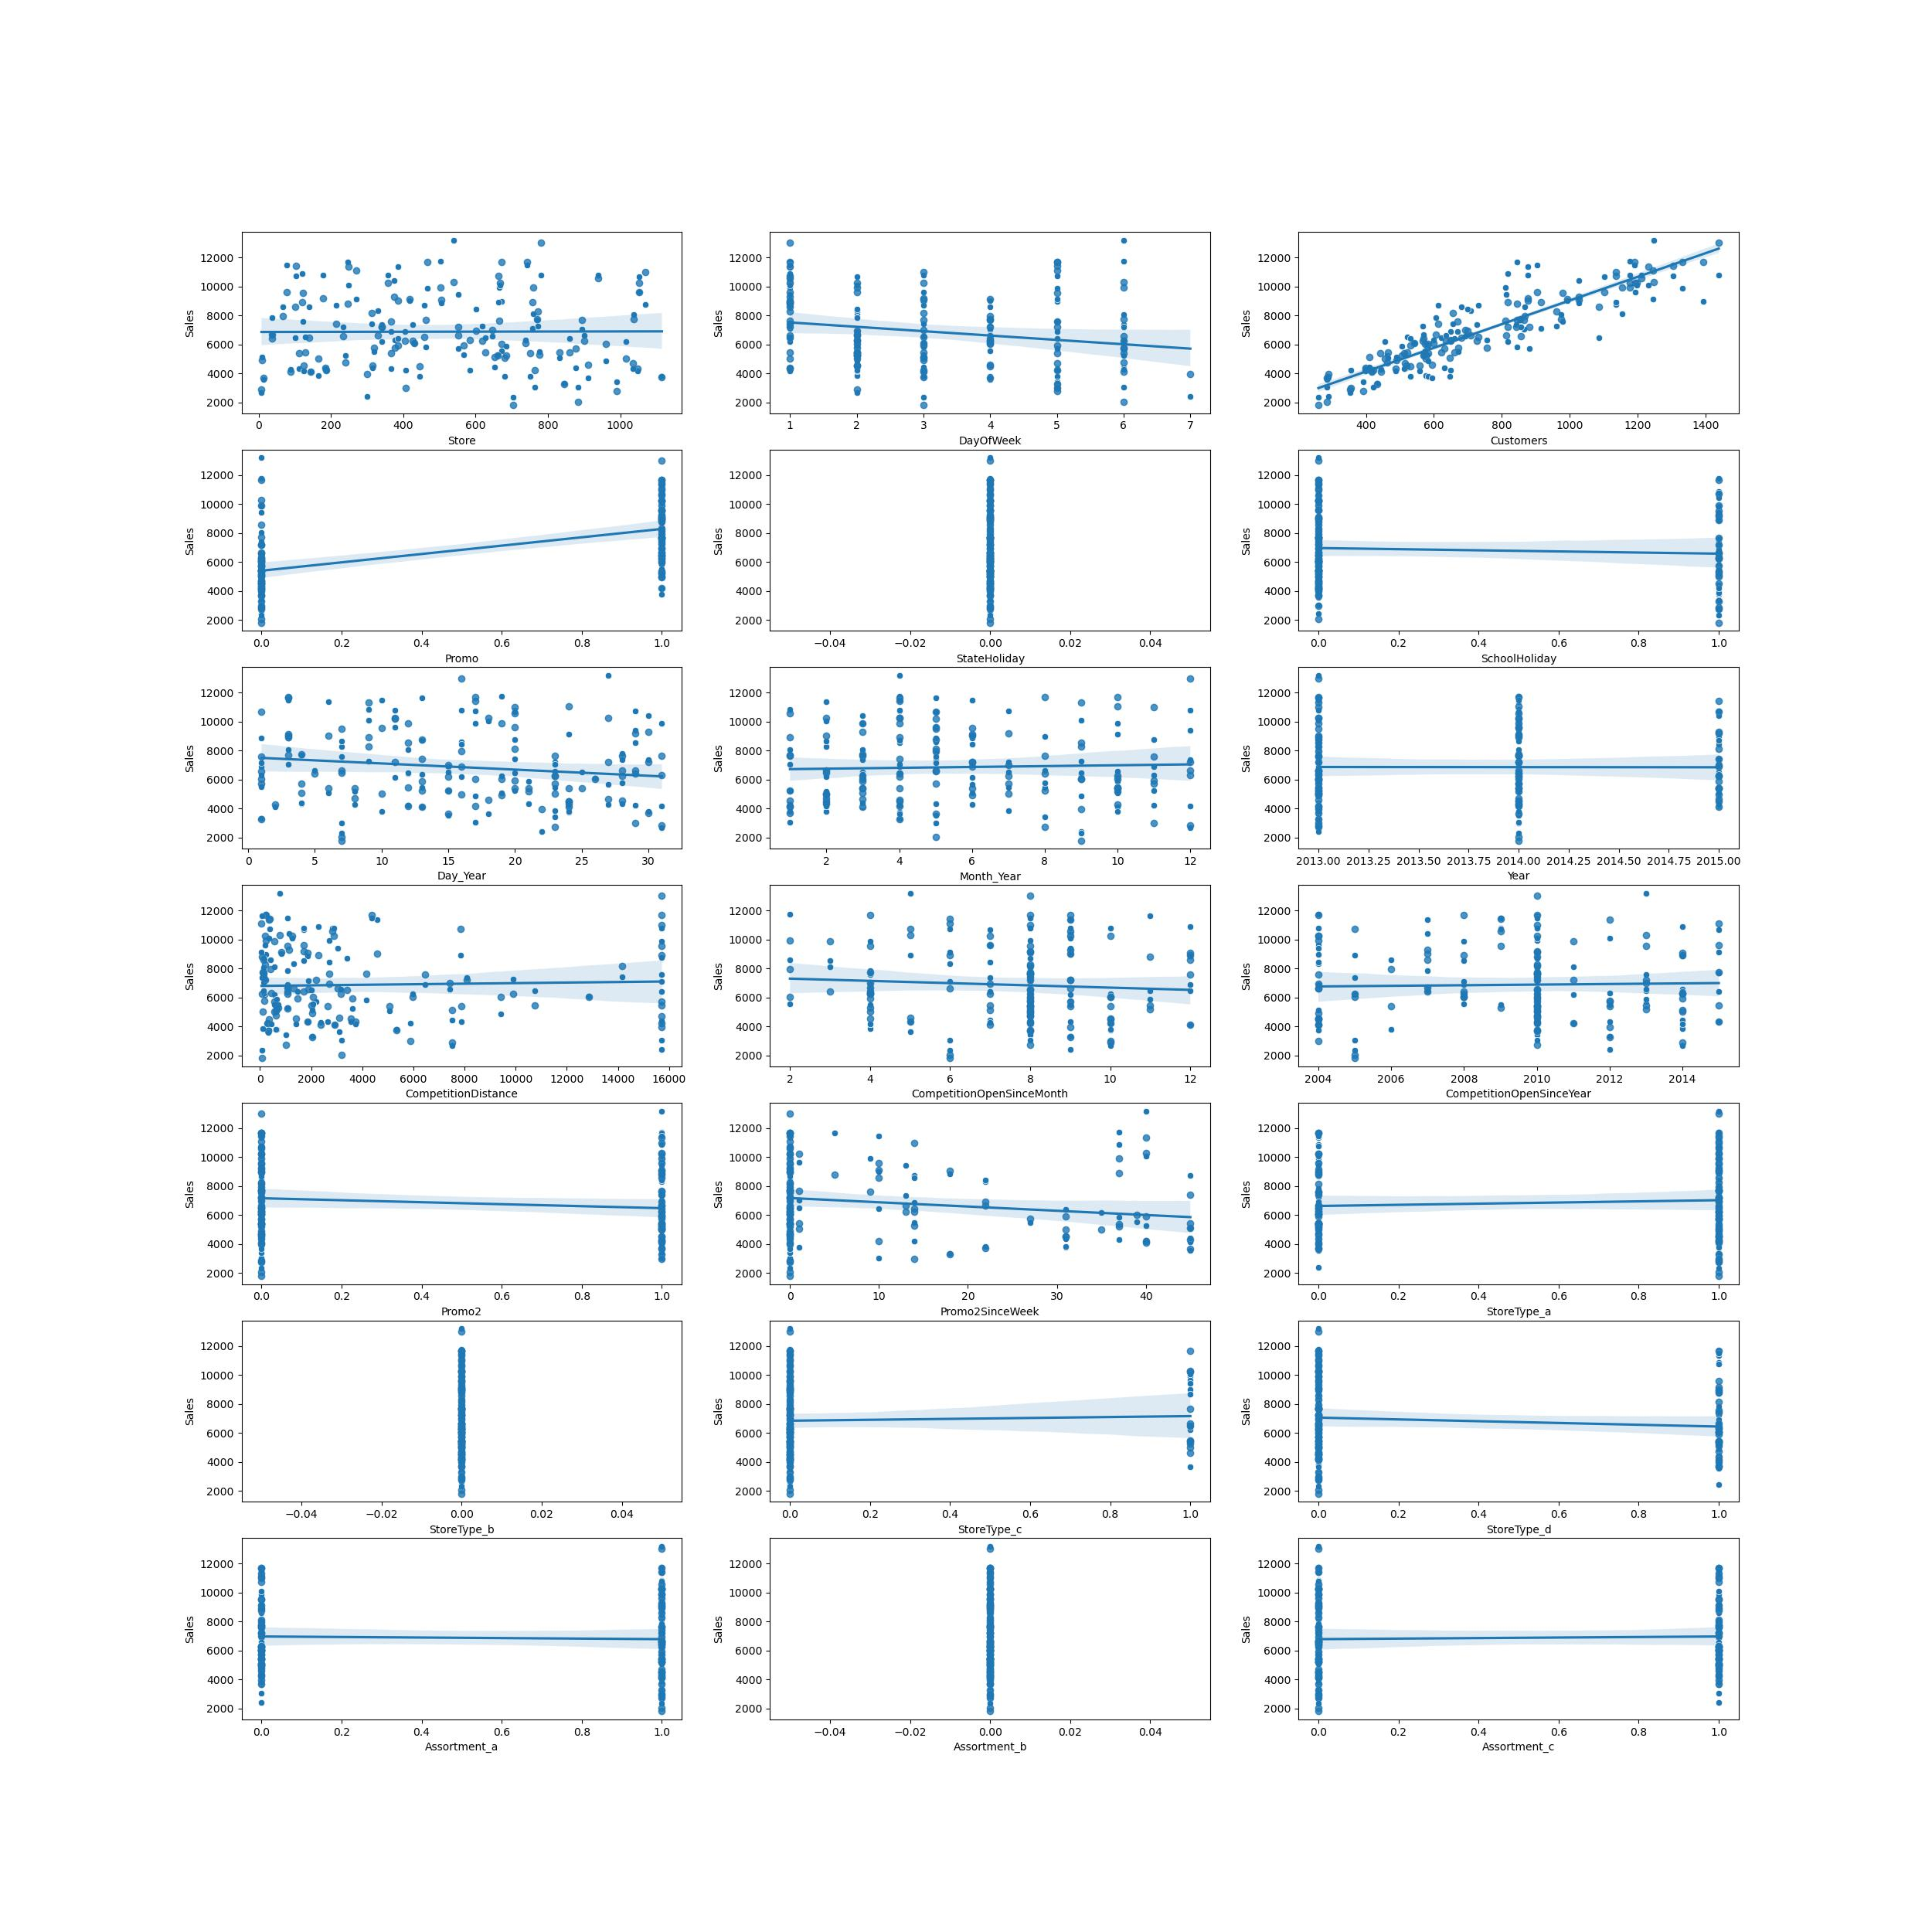
Visualizing Actual Vs Predicted Sales for test data for each variable

Slide 27
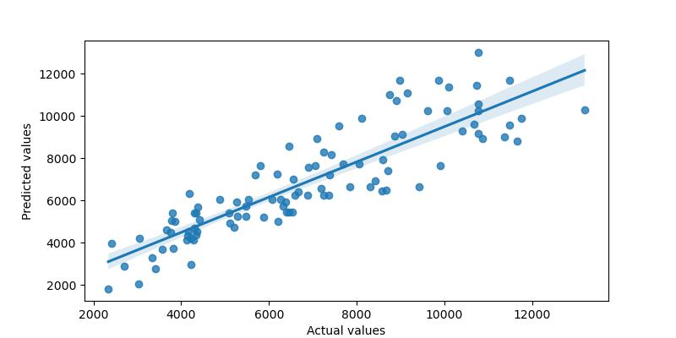
Regression Plot

Slide 28
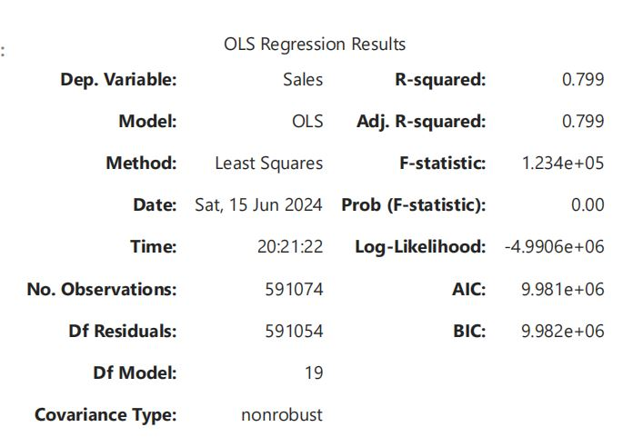
Evaluating The Model

Slide 29
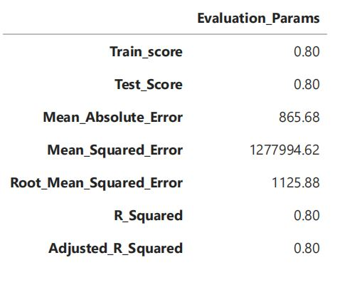
Regression Model Summary

Slide 30
Conclusion
The Model has good training and testing score as well as R squared and Adjusted R squared values
However the Mean Squared Error value is high
Re-Running the Model after dropping some variables like state holiday, assortment_b, storetype_b and CompetitionOpenSinceYear that has less effect on sales predictions as per test data visualization also returned same evaluation parameters.

Slide 31
THANKYOU

